Slide 1
Digitalization of small and medium-size enterprises operations
Diamond 4
Abdul haseeb
Danyal khattak
Kazi Nymul Haque
Saad Zahoor

Slide 2
Challenges
Customer Interests
Supply Chain
Retail
Reporting
Risk Analysis

Slide 3
Basic Idea
Customer Interest (prior)
Using AI tools for collecting data i.e chatbot, hubSpot, Phase LTD etc
Supply Chain
Using Block chain for Supply chain digitalization
Retail
Using Block chain for Retail digitalization
Customer Interest (Posterior)
Automated Reporting by using BI tools like Tableau
Collecting Customer Feedback input it to BI process add it to the prior data
Risk Analysis
Supply Chain Mapping
Business Continuity management
Communication Plan to reduce uncertainty

Slide 4
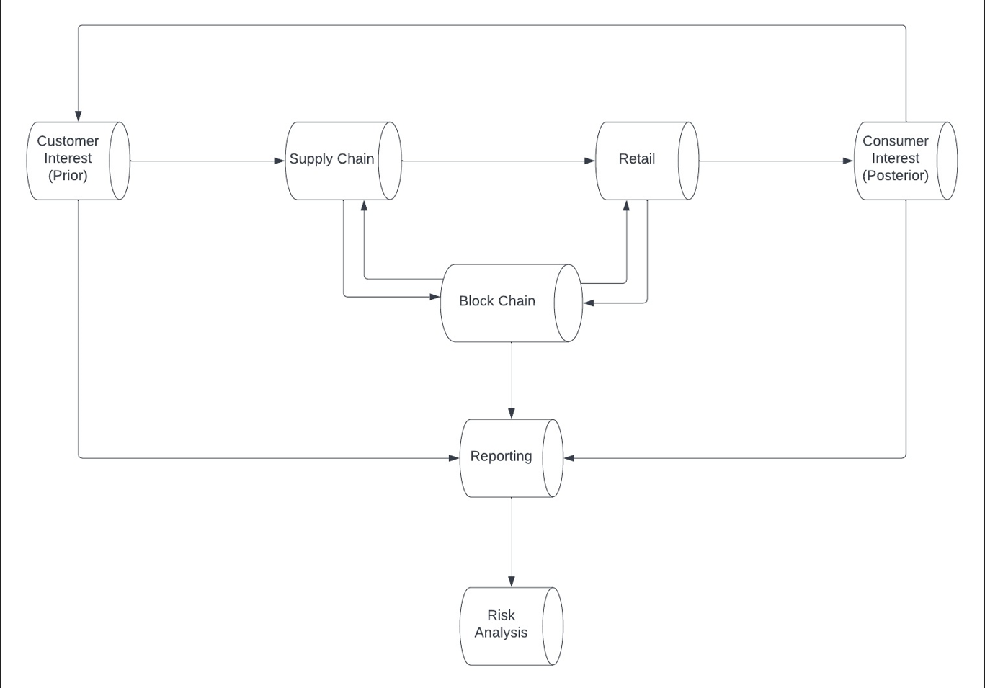
Solution Flow Diagram

Slide 5
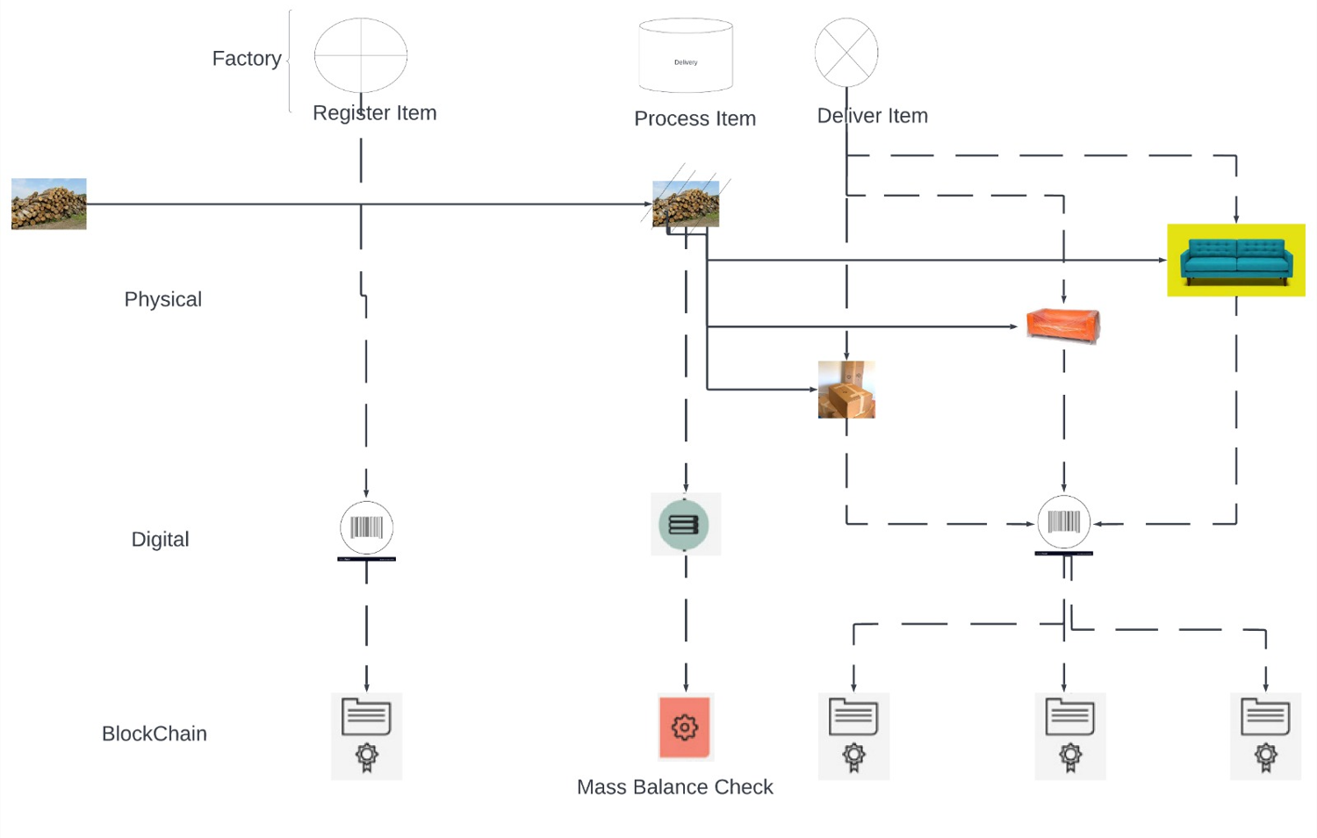
Supply Chain and Retail Flow

Slide 6
Thank You

